Slide 1

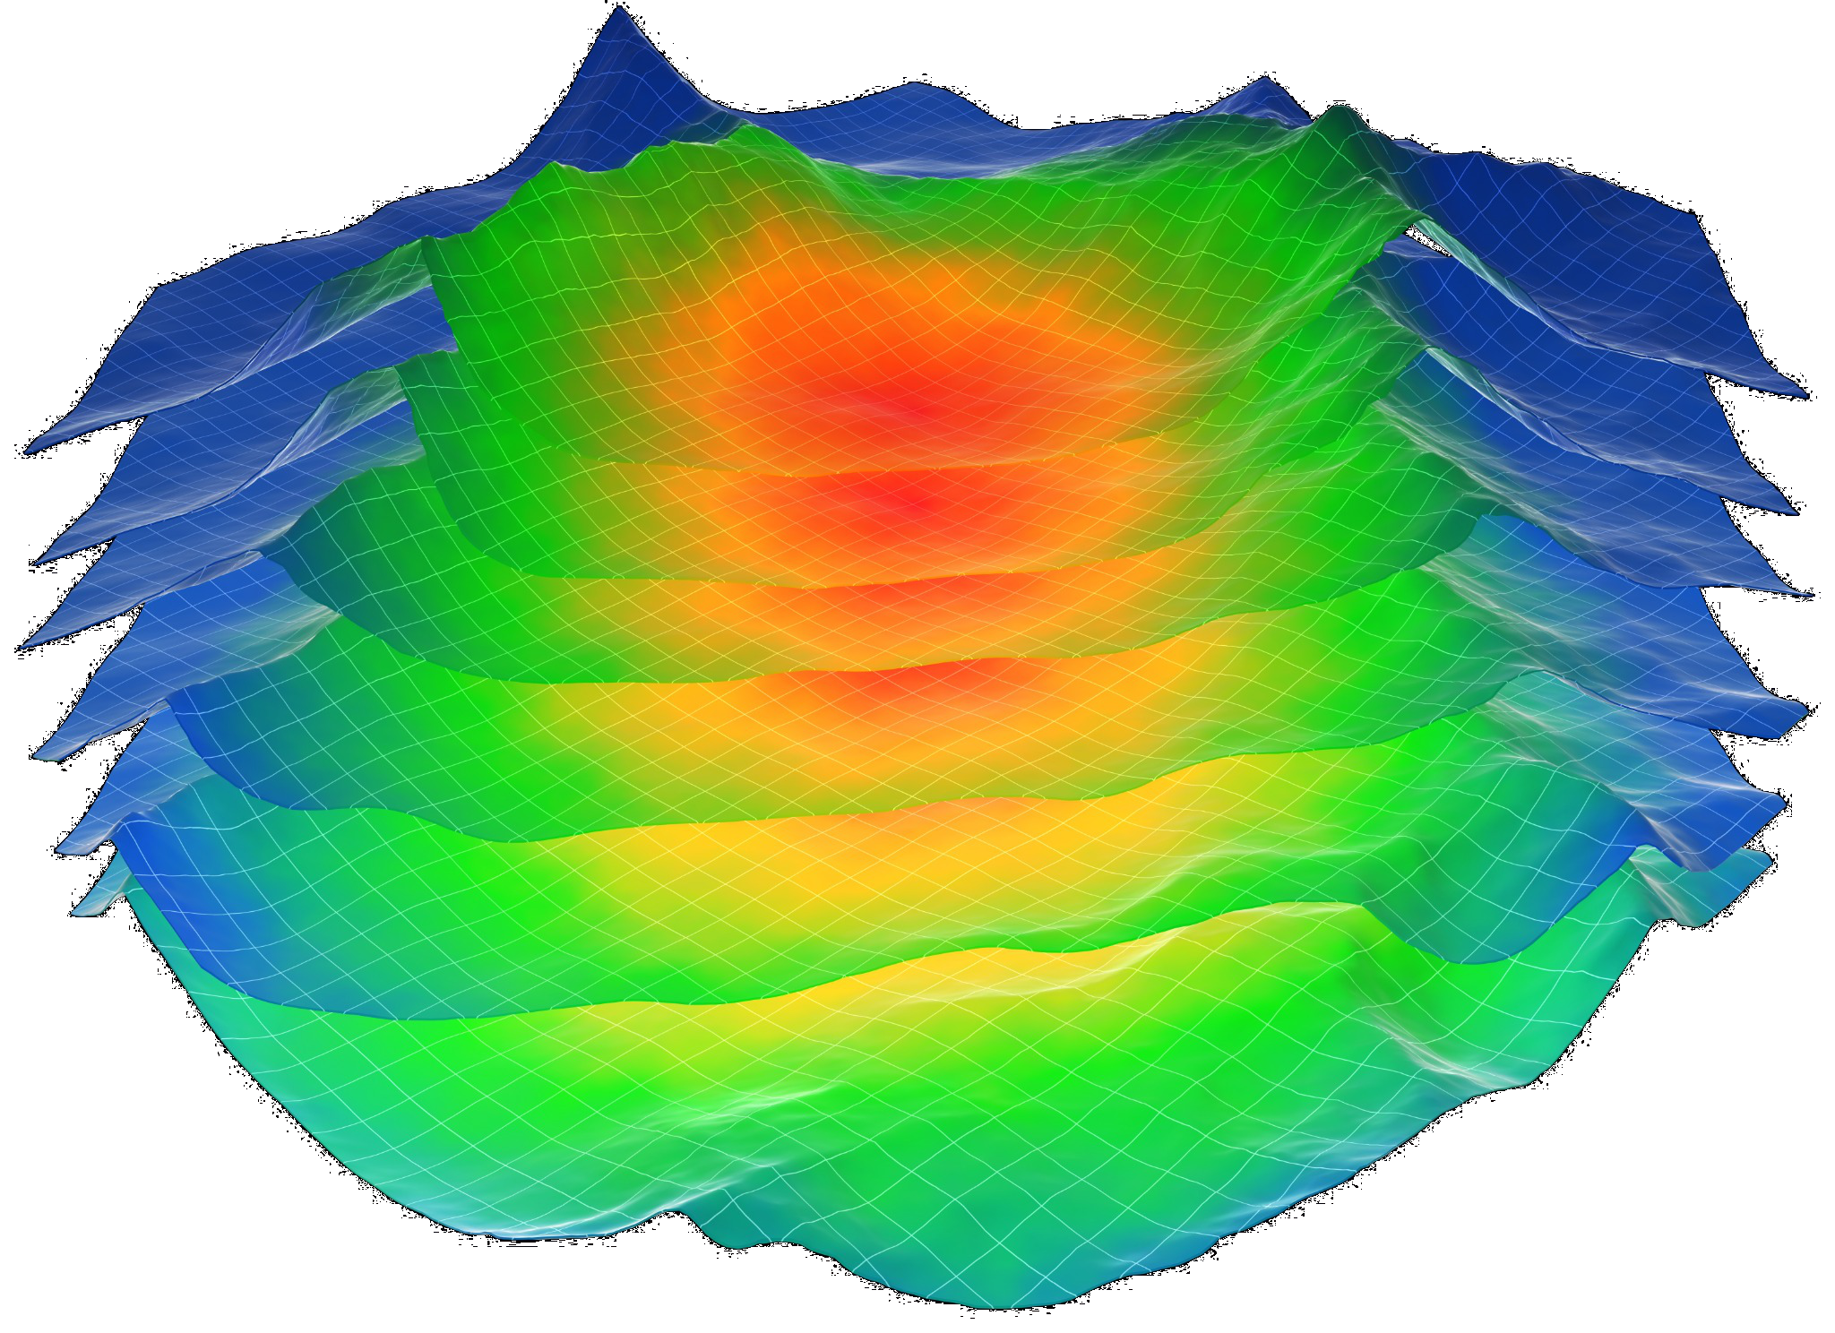
2045 Oil Demand
+16%

Slide 2
Transforming Oil Production with Data Driven Analytics
Naif Alnahash
Harshit Bhavnani
Riley Sansone
Antares Wong
Jnana Kundur Prakash

Slide 3
Business Procedure
EXECUTIVE SUMMARY
Data Collection and Preparation
Analyzing the Data
Prediction & Economics
Created visualization and calculated original and remaining oil.
Classified the oil rate by production performance and location
Conducted interpolation to estimate missing geostatistical values
Proposed drilling location
Utilized regression to predict oil production.
Estimated profit of $7M of drilling a new well over 5 years period
Gathered comprehensive geostatistical and production data.
Preprocessed the data and ensure consistency across all data points
STEP 01
STEP 02
STEP 03

Slide 4
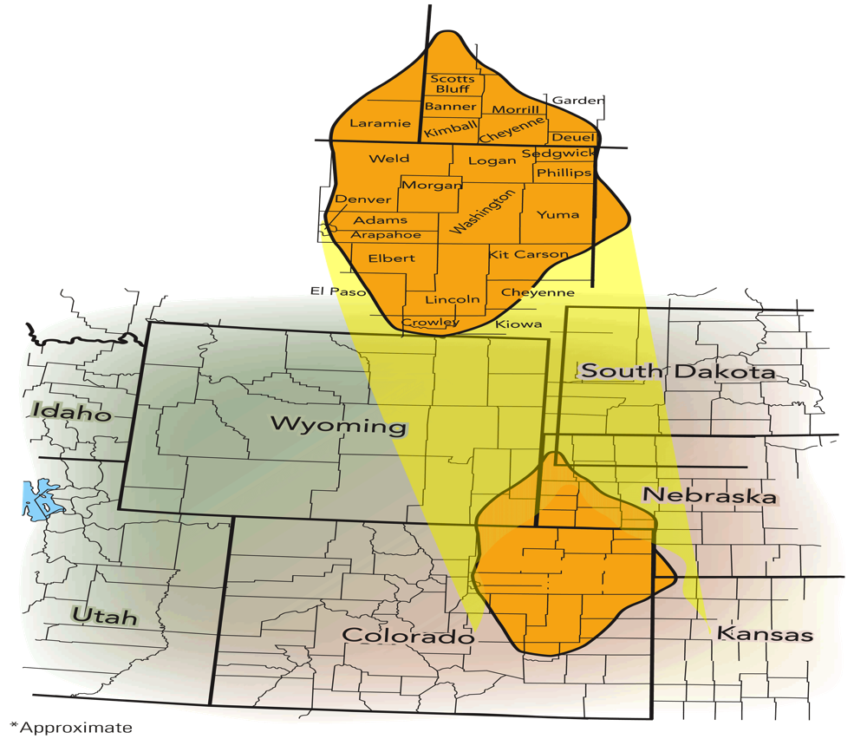

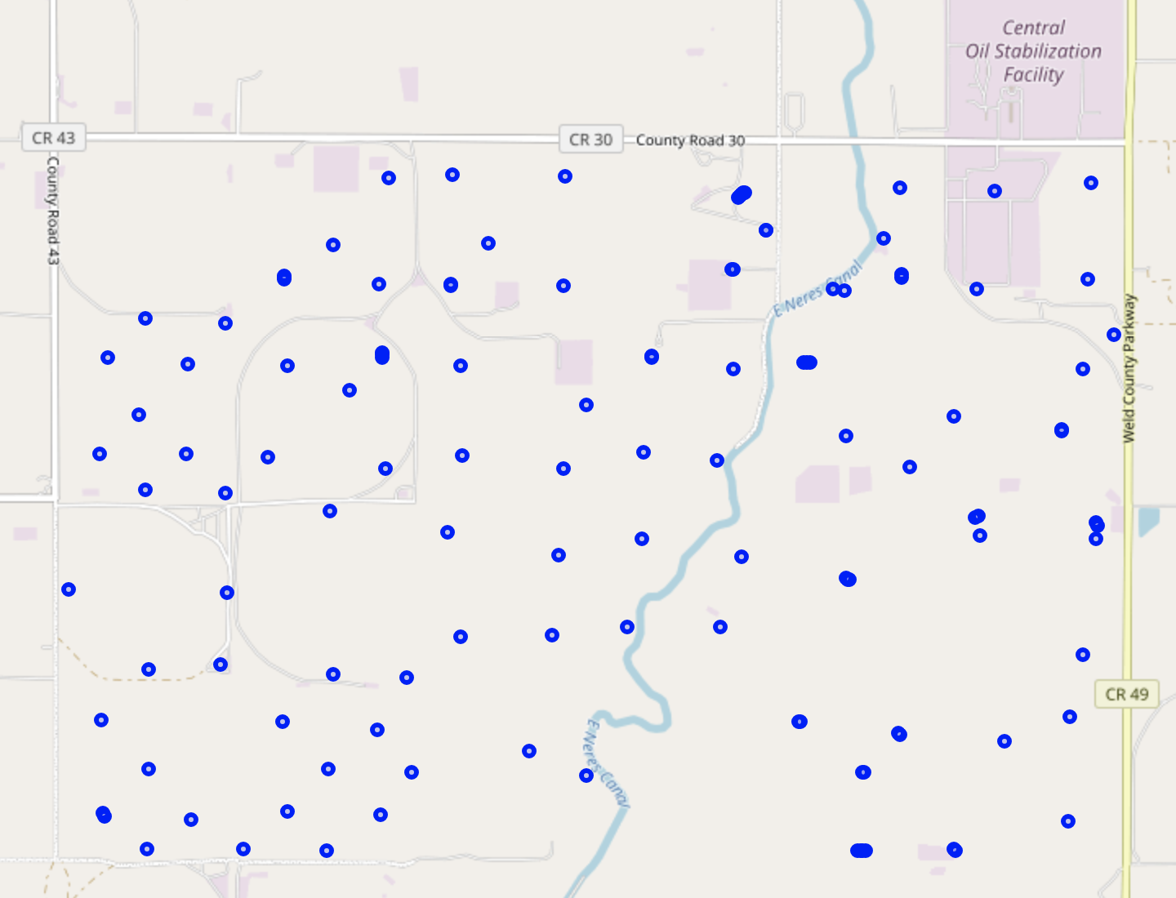
Location
BACKGROUND
Wattenberg Field, NE Colorado
Range 65W Township 3N
Sections: 25, 26, 27, 34, 35 & 36
Data 1999-2022
137 Oil Wells

Slide 5
Available Data
BACKGROUND
Geostatistical Data
Merging Data
Production Data
Well Name
Location (Latitude, longitude)
Well Depths
Thickness
Porosity
Water Saturation
Permeability
Well Name
Total Production Days
Total Oil & Water Production
Oil Production Rate per Day

Slide 6

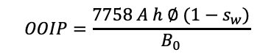


Reserve Estimation
DATA ANALYSIS
Original Oil In Place (OOIP)
Porosity $\overline{∅}$
167 Million barrels of oil
$$OOIP=\frac{7758 A h ∅ (1−s_{w})}{B_{0}}$$
11%
10%
90%
Water Sat $\overline{s_{w}}$
Thickness $\overline{h}$
Total
Production
Remaining
Reserves
55%
216 ft
17 Mbbl
150 Mbbl

Slide 7
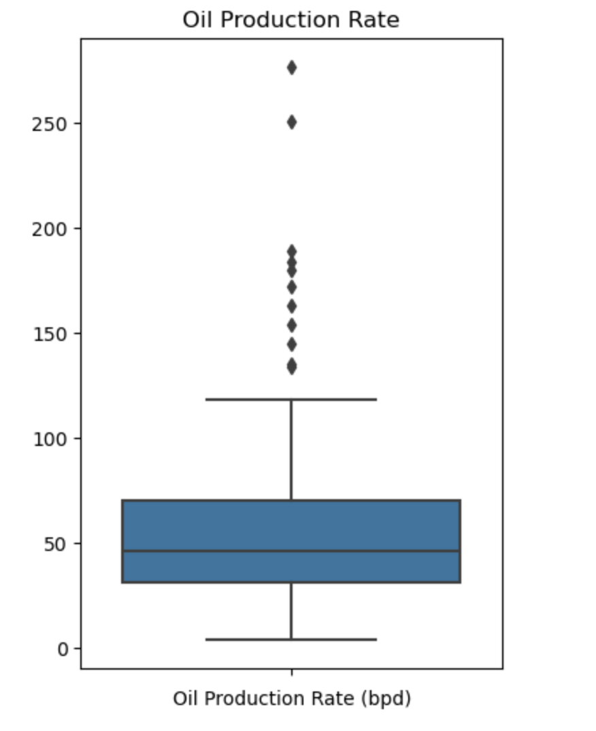
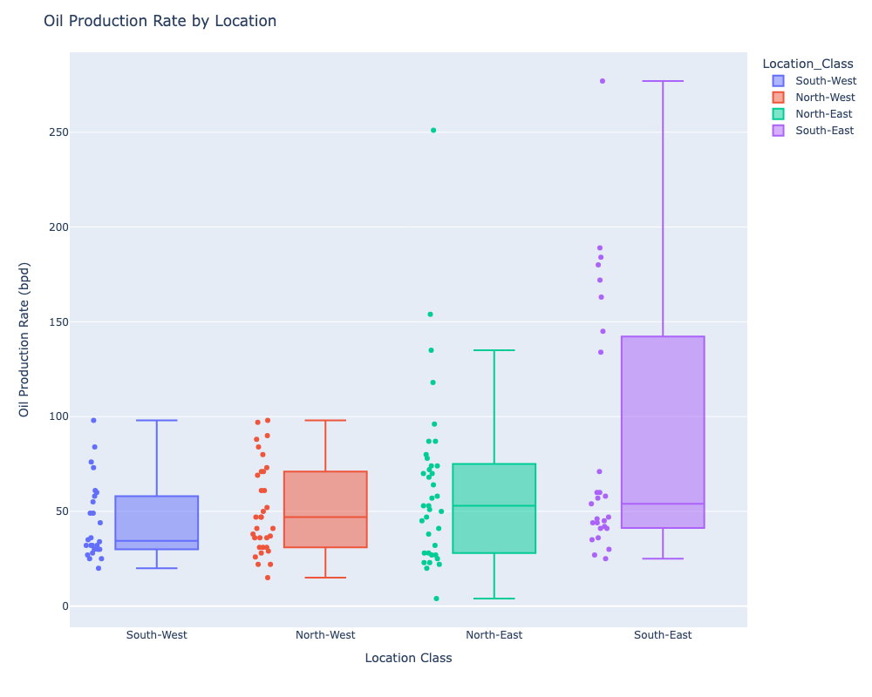
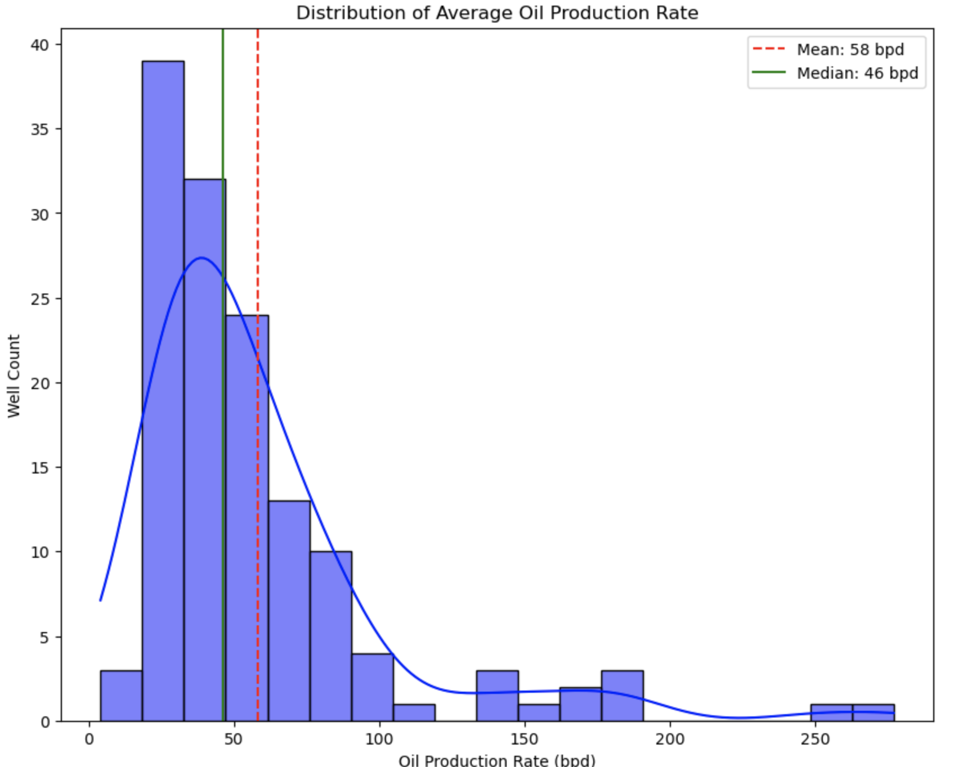
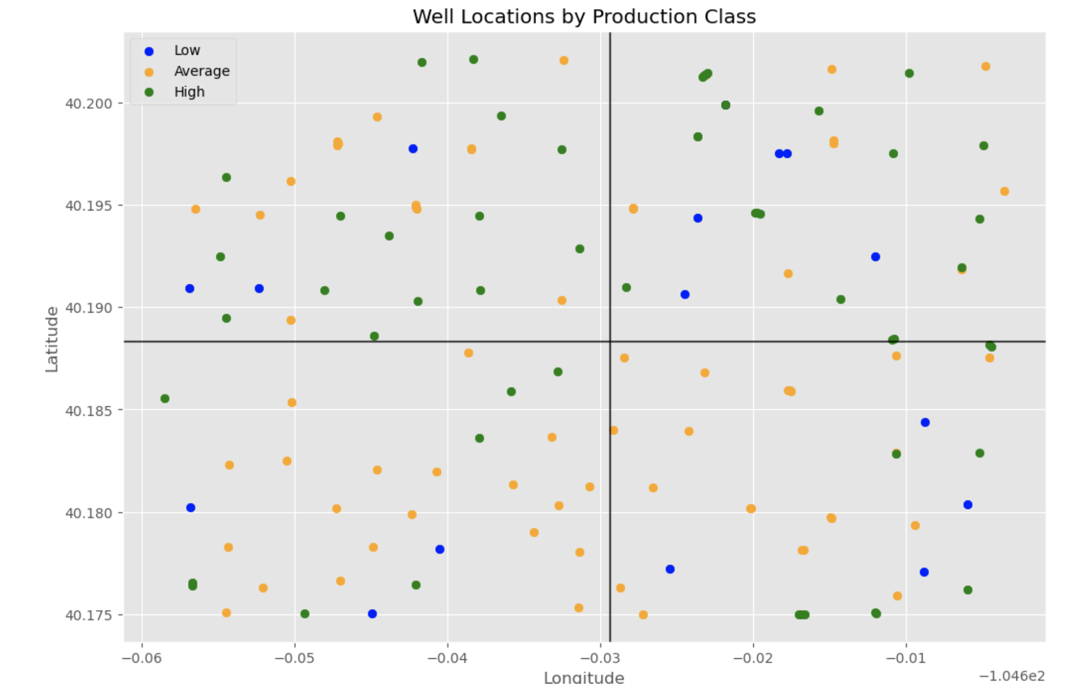
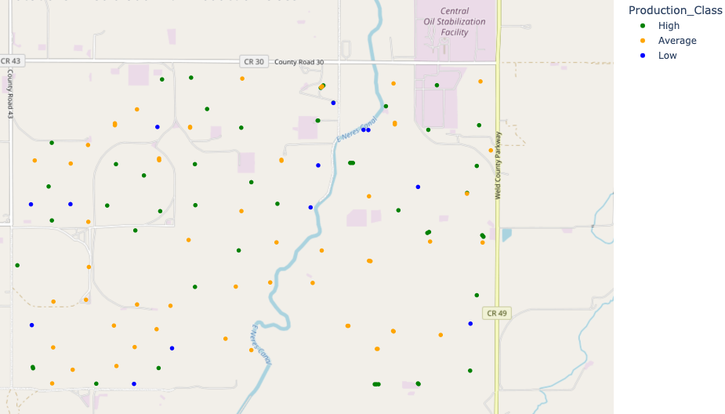
Production Analysis
DATA ANALYSIS
Overall Production
Low
12%
Ave
49%
High
39%
To analysis the production performance
Production Classification
Low : production < 30 bpd
Average: 30-60 bpd
High: production > 60 bpd
Location Classification
Divide the wells into quadrants
and analysis the production

Slide 8
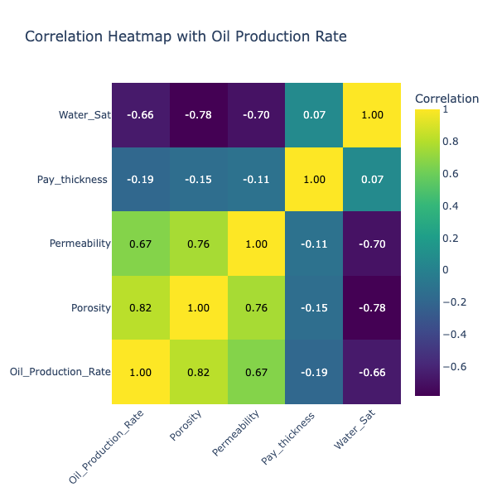
Production Correlation
DATA ANALYSIS

Slide 9
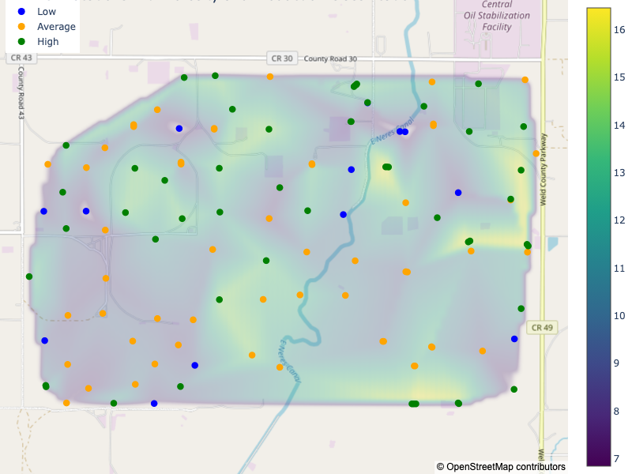
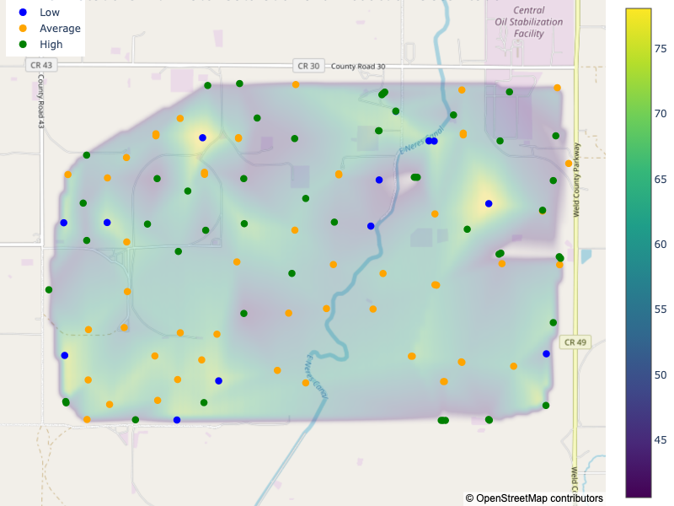
Sweet Spots
DATA ANALYSIS
14%
48%
Porosity Map
Water Saturation Map

Slide 10
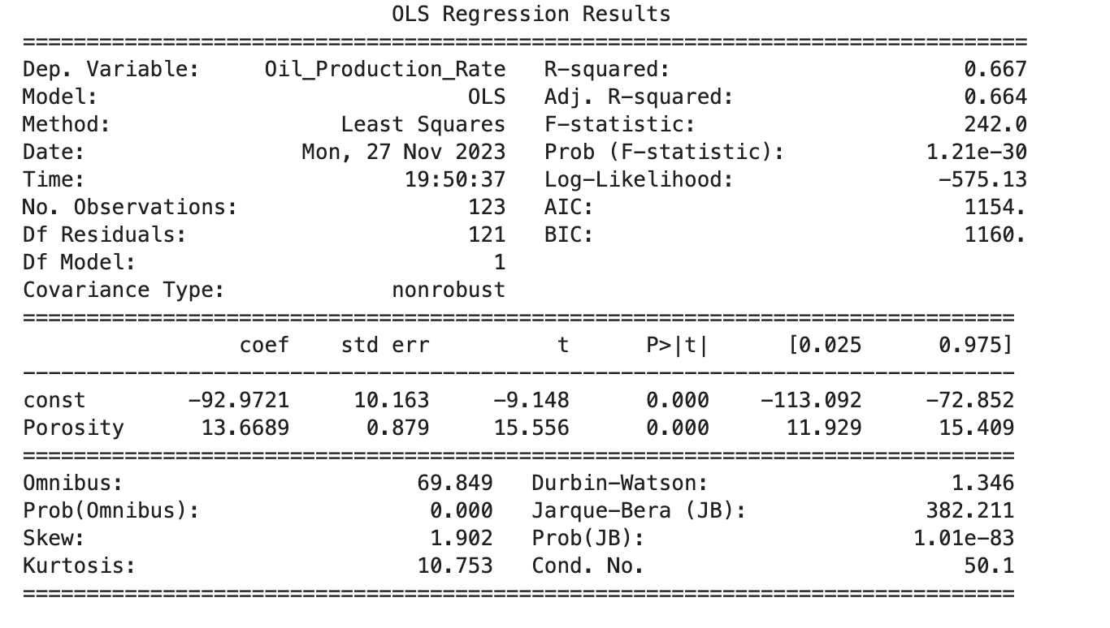
Production Projection
DATA ANALYSIS
Porosity
14%
Oil Production
100 bpd

Slide 11
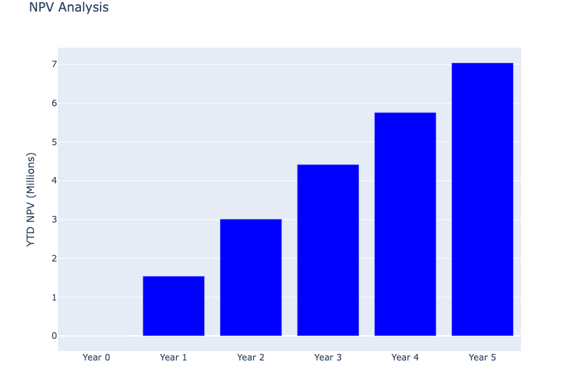
Financial Benefits
ECONOMIC ANALYSIS
100 bpd
$75/bbl
$7M

Slide 12
Thanks

